Slide 1
VIEWS, LIKES, DISLIKES, COMMENTS…that’s trendy
By Lauren Lopez

Slide 2
Introduction
The history of YouTube?
What is a trending video?
What are the characteristics of a trending video?
The purpose of this study.
The kaggle data set includes 40,881 observations and 14 variables.

Slide 3
Required Packages
The most important portion of the project is installing and loading packages.
To do this you use the library() and install.packages() functions.

Slide 4
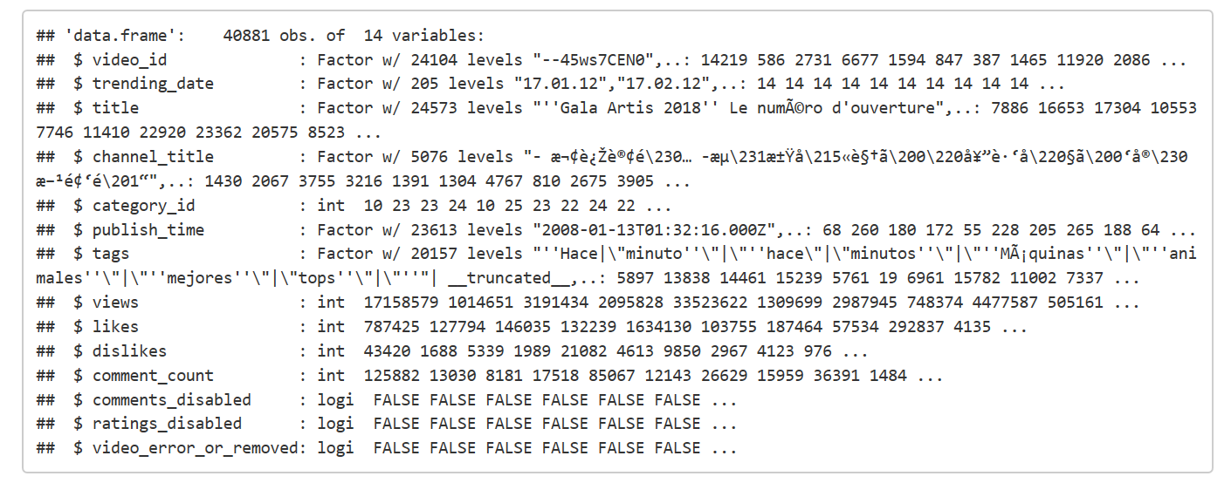
Structure of the Data
Notice that there are 40881 observations = rows and 14 variables = columuns.

Slide 5
Data Wrrangling
Data wrangling is one of the most essential parts of a data science project.
Data wrangling is the process of mapping data from raw to a format appropriate for the data to be analyzed.
Data wrangling consists of selecting, indexing, and mutating the tables to form them for your need. This process helps with better decision making, but it takes a long time to complete.
If it is done correctly, then a data scientist life is made easier. These steps will help to deliver more accurate results.

Slide 6
Particular Data Wrangling techniques
The data set was almost clean.
There were 8 columns removed from the data set.
All missing data was removed from the data set.
A filter was created to reduce the range between the lowest and highest data points.
A popularity index was created to distinguish between highly trending and trending videos.
Seven variables and 39,924 observations were left after the data wrangling process was completed.

Slide 7
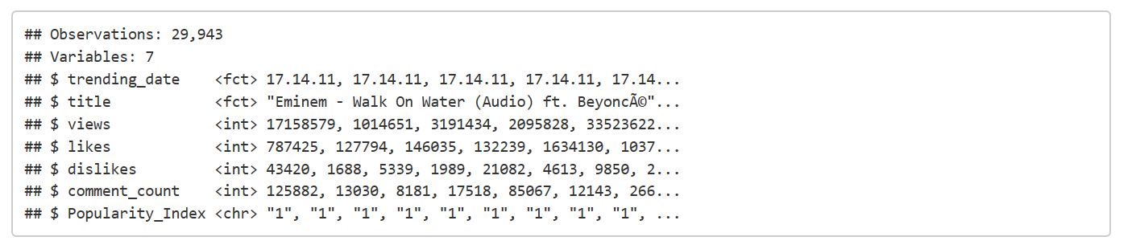
Glimpse function
A glimpse of the data set shows the 299943 observations and 7 variables. The popularity index
was added.

Slide 8
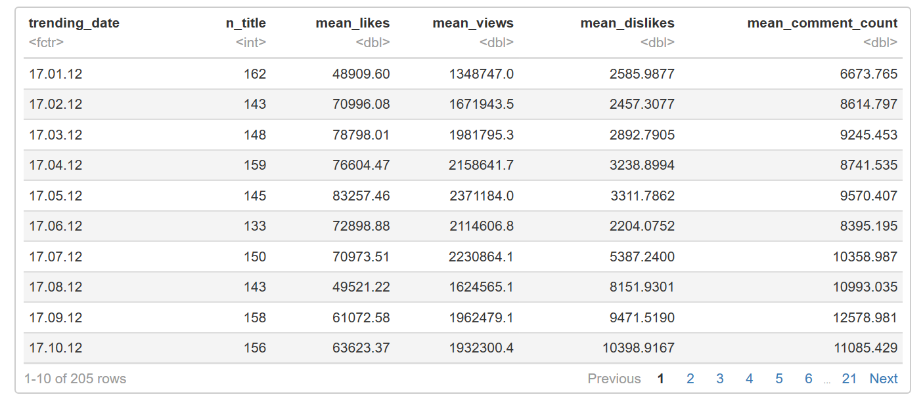
Statistical analysis
Since there is an enormous amount of data for trending videos, the means of
each variable is explored grouped by trending date.

Slide 9
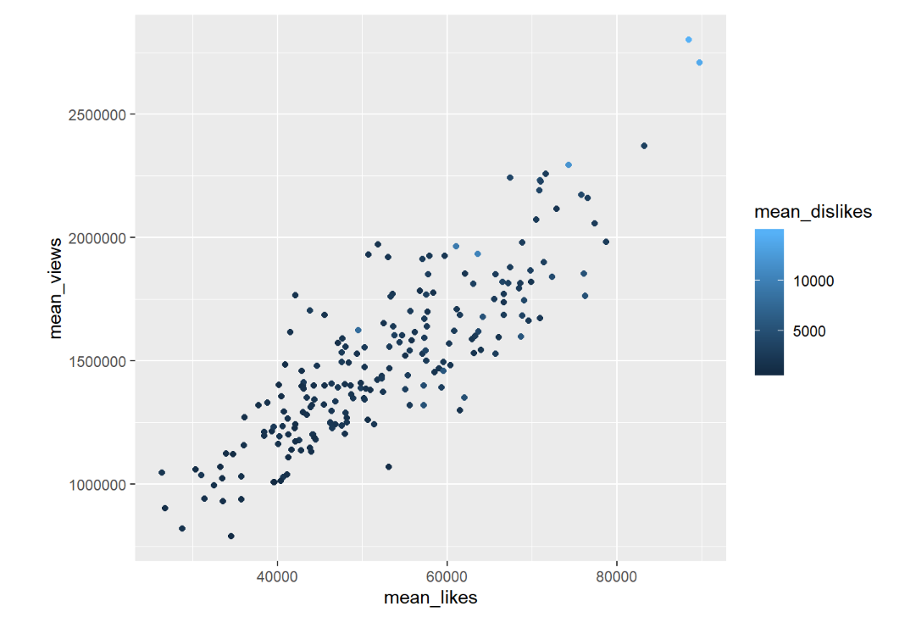
MEAN Likes vs views
There is a positive relationship between the mean number of views and mean number of likes.
The light blue dots shows there is a high number of dislikes. The table shows that high trending
videos have a high number of likes, views, and dislikes.

Slide 10
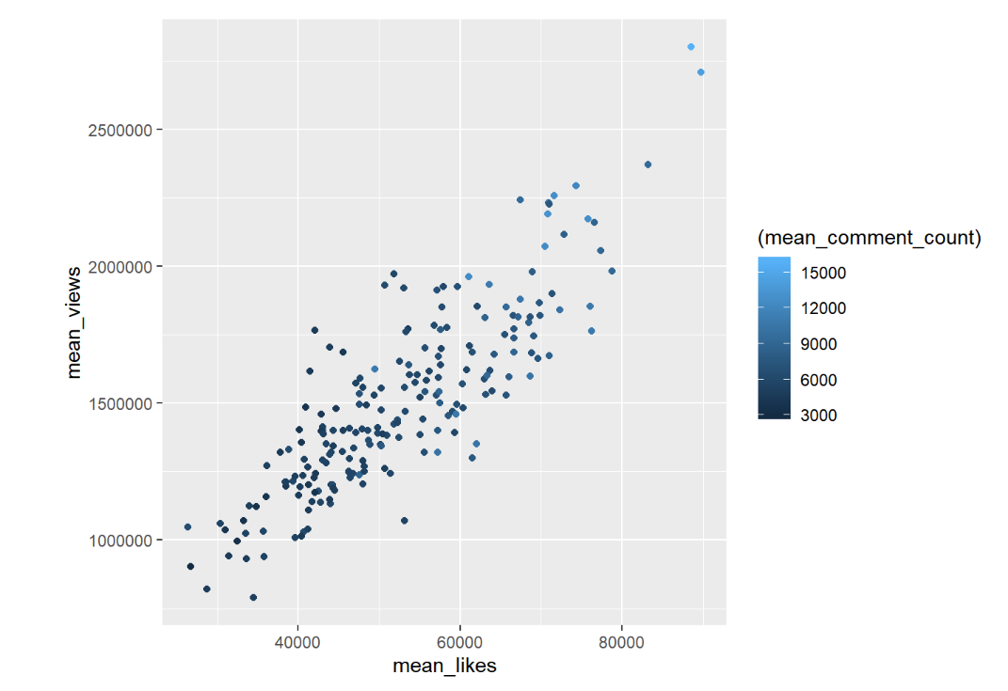
Mean LIKes vs Views
The table shows that high trending videos have a high number of likes, views, and comments.

Slide 11
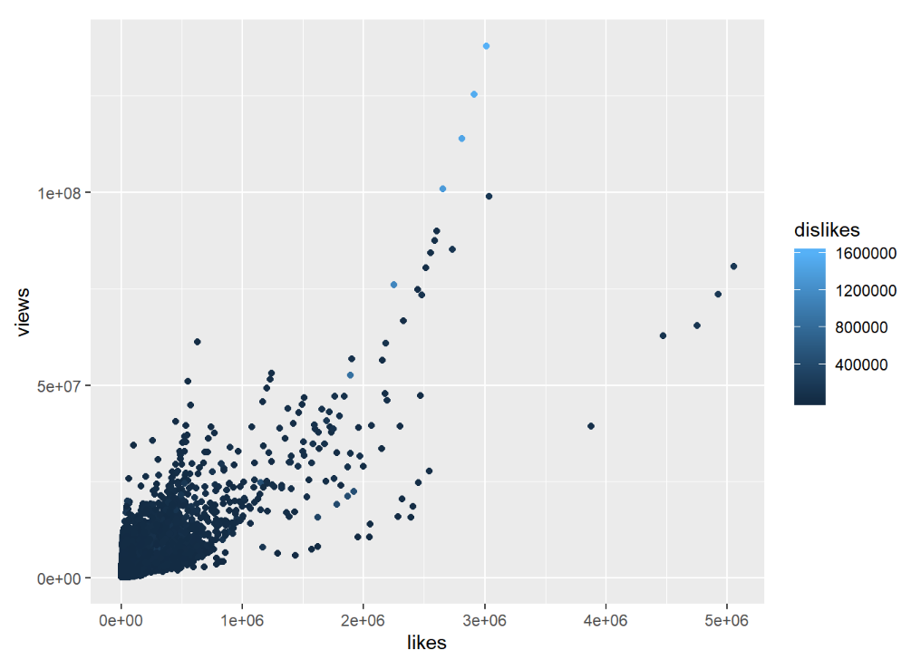
Actual Likes vs views
The relationship is linear but lots of the data clumps near the origin.

Slide 12
Difference between mean and actual data values
Actual data does not show a strong linear relationship between variables as the mean data.
Both data sets show that a high of likes, dislikes, comments, and views are characteristics of trending data sets.

Slide 13
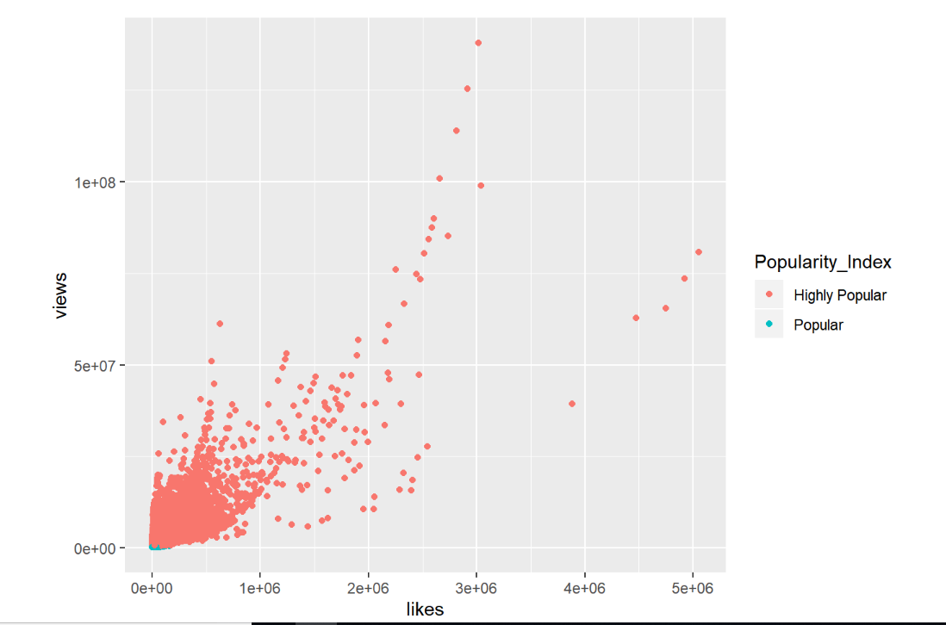
Highly Popular VS Popular
The graph shows that the filter did a great job of removing the popular videos.

Slide 14
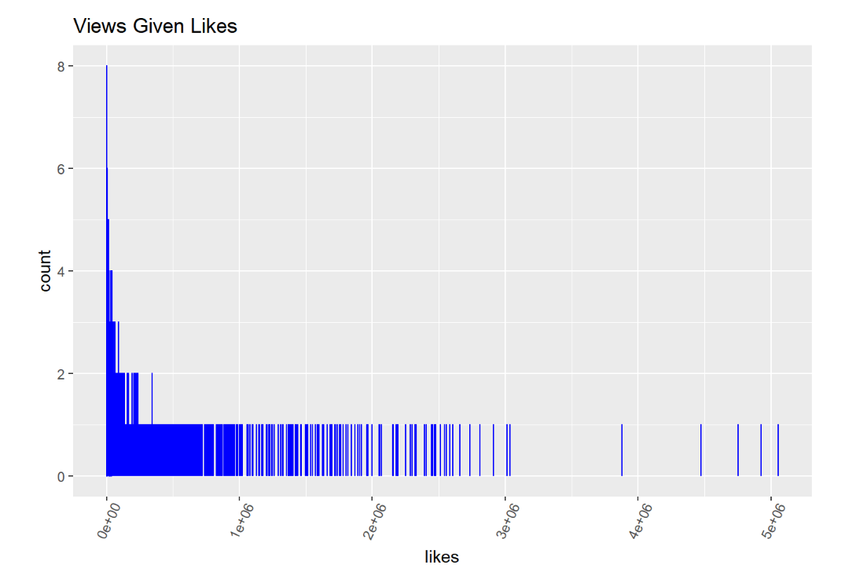
Views given likes
This histogram shows the outliers in the data set and also shows the high count level.

Slide 15
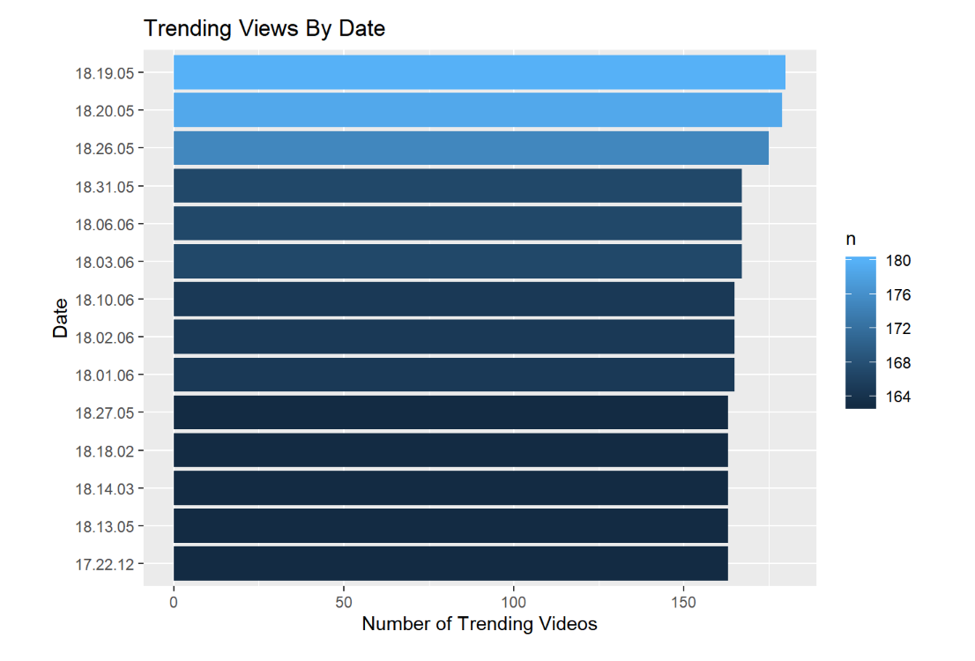
Trending by date
The graph shows the dates that had the highest number of trending videos.

Slide 16
Machine Learning
The plots and models are created, and a clearer understanding of the data set has been achieved. Since the dependent variable is a numerical value, multiple linear regression will be used as the machine learning technique.
For the machine learning portion of the capstone project, the number of views is predicted given the number of likes, dislikes, and comments.

Slide 17
Training SET, TESTING set, METRICS
The divide used is 80% to train the model and 20% of the data to test the model.
To determine if the model of best fit is a good model the metrics R-squared RMSE, and p-value are observed. The model is built using the original data and not the daily means of the data.

Slide 18
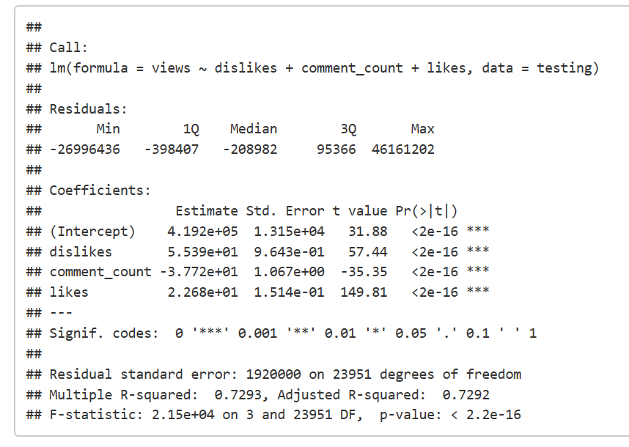
Model of best fit (Trianing)
The first model is creating with views as the dependent variable and likes, dislikes, an comments as the dependent variable.

Slide 19
Metrics for model of best fit (Training)
The three variables are statistically significant. Since p is less than 0.05.
The R^2 values is 0.73. Shows that the model is good.
The residual standard error is 1920000. This value reflects the number of views that varies from the line of best fit.
The model can be better but it is good at predicting the number of views given likes, dislikes, and comments.

Slide 20
The Equation for the model

Slide 21
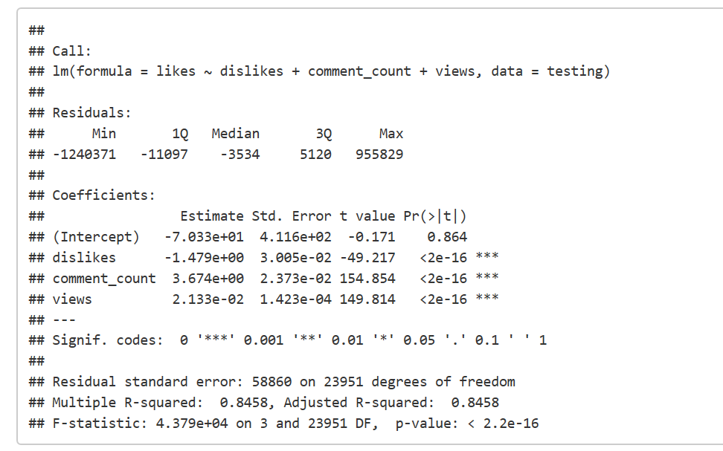
Testing the model
The model summary shows how the testing data performed. It helps to solidify the model.

Slide 22
Testing model metrics
The three variables are statistically significant. Since p is less than 0.05.
The R^2 values is 0.85. Shows that the model is good.
The residual standard error is 58860. This value reflects the number of views that varies from the line of best fit.
The testing model is better than the training model. For consistency try to repopulate the training and testing data using a different set counter.

Slide 23
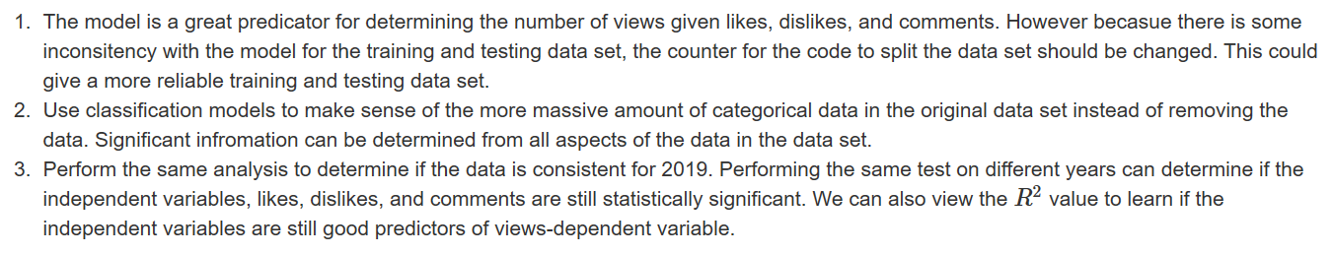
Recommendations

Slide 24
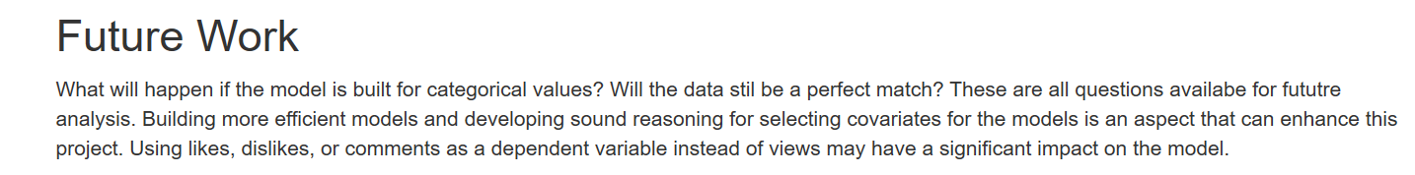
Future work

Slide 25
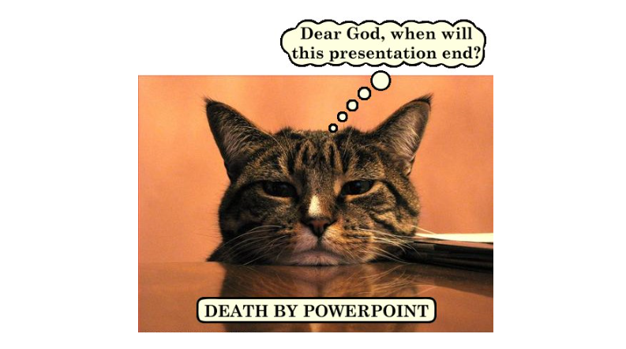
questions

